Slide 1


DATA SCIENCE PROJECT ON
BANKRUPTCY PREVENTION

Slide 2
BANKRUPTCY PREVENTION Presented by ( Project Group – P78 , Team Number – 03 )
Team Members : Mentors :
Arbaz Khan 1. Varun
Piyush Mahajan 2. Himavanth
Geetanjali Vijayakumar
Shruti Chaturvedi
Nazia Parveen
Nitin Salian
Date : 02/12/2021

Slide 3
Details
Business Problem
Objective
Data Set Used
To predict (bankruptcy or non-bankruptcy)
The goal here is to model the probability that a business goes bankrupt or not from the different Independent features given in dataset
bankruptcy-prevention.csv

Slide 4
What is Bankruptcy ? ( Feature / Dependent Variable Description )
Bankruptcy is a legal process through which people or other entities who cannot repay debts to creditors may seek relief from some or all of their debts.
When any organization or person fills for Bankruptcy, their assets or other investment related to business get sold and used to pay debt.
There are various reasons behind bankruptcy of company or any business.
The reasons may be endogenous (Internal) or exogenous (External) to business.
The endogenous includes management errors, lack of capital, competitiveness and others.
The exogenous includes market crisis, political factors etc.

Slide 5
Factor affecting Bankruptcy ( Feature / Independent Variable Descriptions )
The following factors are considered for prediction of bankruptcy:
1. Industrial Risk :
It refers to the factors that can impact a particular industry, which can turn affect the companies within the sector.
For example a tax increase in the automobile industry may adversely affect the profits of the automobile producers due to the sharp decline in the sales volume.
Industries face various types of risks like technological shifts, politically induced tariffs, competitive threats and other reasons. The mature industries generally have lower industry risk and emerging industries which face higher uncertainty and so higher risk.
2. Management risk :
This is the risks associated with ineffective, destructive or underperforming management.
Bad management lead to other problems in company like in funding, employee dissatisfaction, corruption etc.
Higher the Management risk, higher to probability of bankruptcy.

Slide 6
3. Operational Risk :
Operational risk is resulting from errors or failed internal process, people and systems of company
The most important types of operational risk involve breakdowns in internal controls and corporate governance. Such breakdowns can lead to financial losses through error, fraud and corruption.
Other aspects of operational risk include major failure of information technology systems or events such as major fires or other disasters.
4. Credibility :
credibility means to which consumers believe that a firm can design and deliver products and services that satisfy customer needs and wants.
These dimensions help to influence consumer attitudes and persuade them to purchase a company's products or services.
Credibility in business is key in helping your company attract both employees and customers as well as investors.
It also help when applying for loans, negotiating terms, troubleshooting production issues or requesting an extension on credit.

Slide 7
5. Competitiveness :
Competitiveness is a measure of the ability to compete within a business sector.
It is also referred to as the organization's ability to act and react through its financial strength.
Competitiveness should be higher for a company, which tell that the company have a strength of compete with other.
Higher the competitiveness lower the risk of bankruptcy.
6. Financial Flexibility :
Financial flexibility is the measure of an organization’s ability to do what it wants when it wants without compromising the larger financial picture.
The company able to make quick decision because of financial flexibility. Hence we can say that the company is financially more strong.
Higher the financial flexibility, lower the chances of bankruptcy.

Slide 8
PROJECT ARCHITECTURE / PROJECT FLOW
Data Collection (bankruptcy-prevention.csv)
EDA
ii - Feature Extraction
iii - Balancing The Data
Splitting Into Train & Test
Model Building
Model Evaluation
Deployment
i - Encoding Variables & Visualizations

Slide 9
DATA SET DETAILS
Sr No. | Attributes | Description
1 | Total Number of variables | 7
2 | Number of observations | 250
3 | Variable types | Float – 6 Object - 1
4 | Missing cells | 0
5 | Duplicate rows | 147
6 | Total size in memory | 13.8+ KB

Slide 10
DATA SUMMARY
Numerical variables –
industrial_risk: 0=low risk, 0.5=medium risk, 1=high risk.
management_risk: 0=low risk, 0.5=medium risk, 1=high risk.
financial flexibility: 0=low flexibility, 0.5=medium flexibility, 1=high flexibility.
credibility: 0=low credibility, 0.5=medium credibility, 1=high credibility.
competitiveness: 0=low competitiveness, 0.5=medium competitiveness, 1=high competitiveness.
operating_risk: 0=low risk, 0.5=medium risk, 1=high risk.
* The values are encoded into : 0 = low , 0.5 = medium, 1 = high, in all Numerical Variables.
Categorical variables –
The “class” feature in the target variable having two unique Categorical values : bankruptcy and non-bankruptcy.

Slide 11
TABLE OF CONTENTS
01.
02.
EDA
VISUALIZATIONS & ENCODING VARIABLES
Exploratory Data Analysis – Cleaning of Data
Visualize & Encode the Data for the Insights
MODEL BUILDING & EVALUATION
03.
Building Up The Model & Evaluating It
04.
DEPLOYMENT
Deploying The Model

Slide 12

01.
EDA – ( Exploratory Data Analysis )
Exploratory Data Analysis -Cleaning the Data

Slide 13
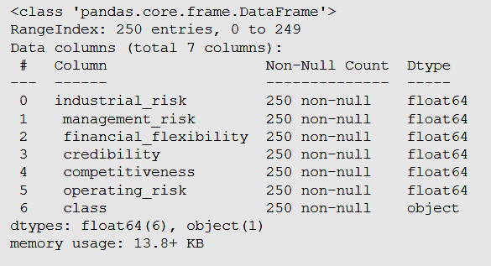
1. After Loading the Dataset we found out that there are no-null values in the Dataset.
2. No mixed datatype columns only (have float64 and object)

Slide 14
3. We renamed the Columns as their were Spaces in Variable Names & Class Variable to “target_variable”
4. So now the data is cleaned, we can apply the visualization methods on the data to get the more insights from the data.

Slide 15
02.
I - VISUALIZATION
Visualizing The Data

Slide 16
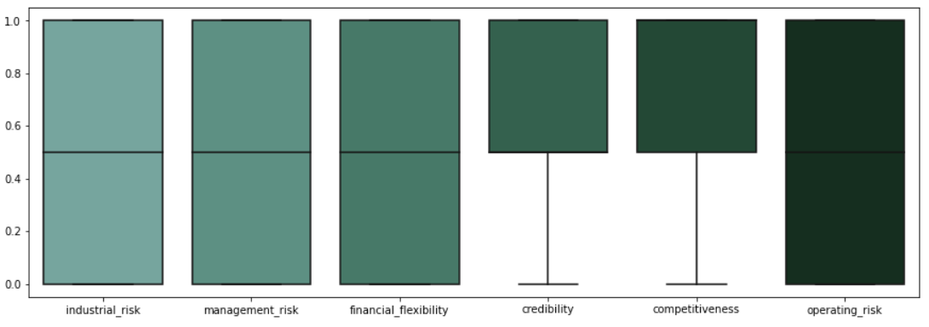
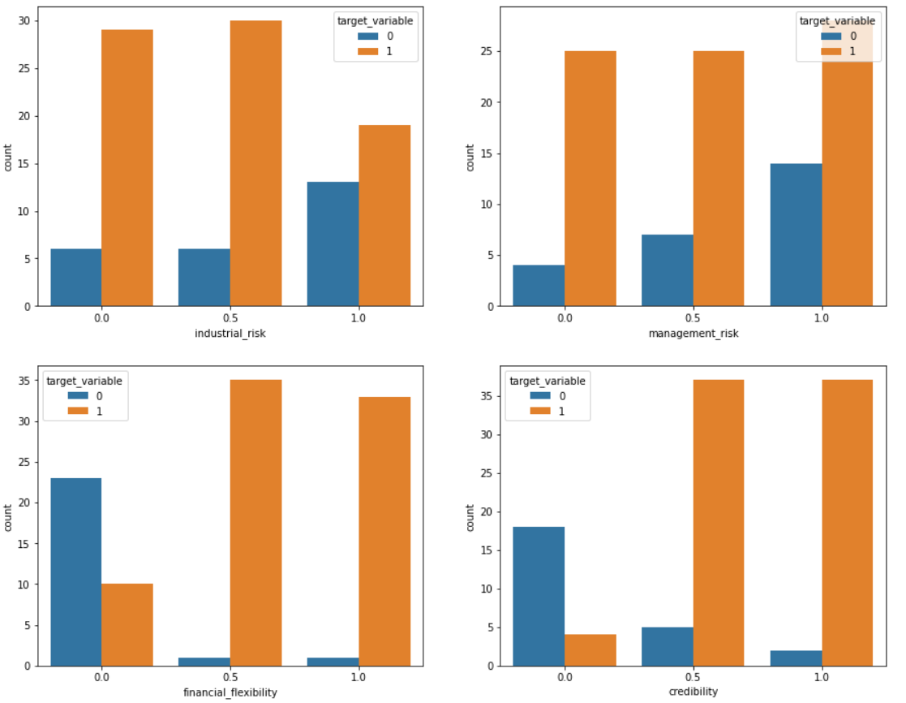
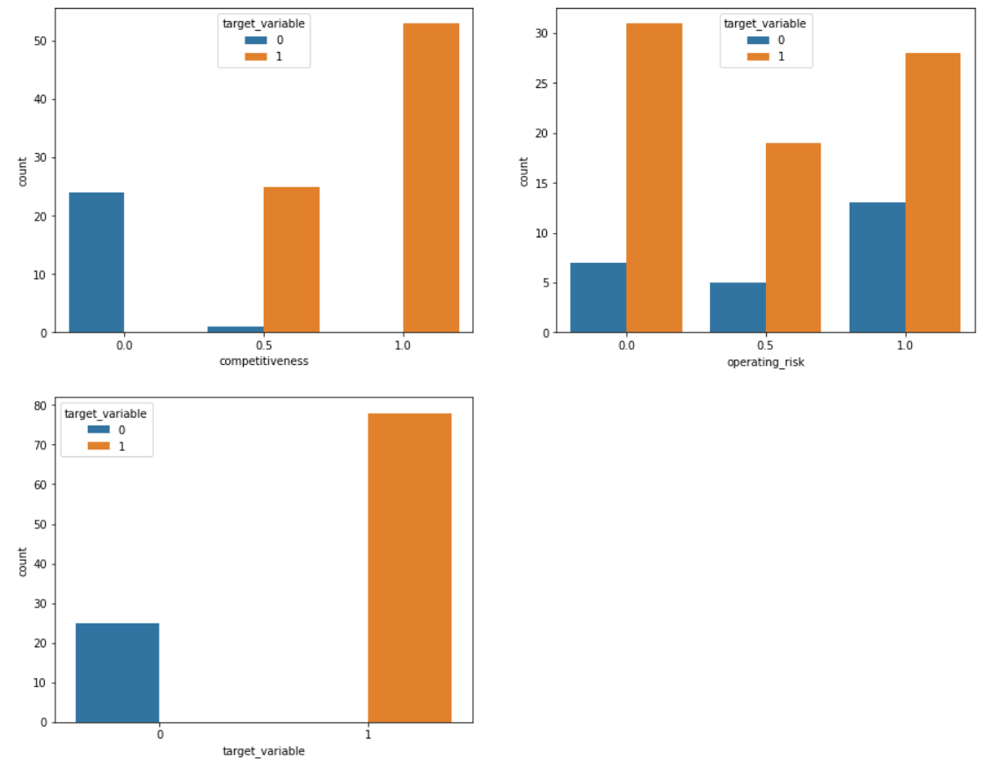
1. We Used ‘Box Plot’ to find out the outliers , but from the visuals of the box plot their were no OUTLIERS.
2. Than to see the distribution of the data we use ‘SUB PLOT’ , & we found out that the data is quiet unbalanced

Slide 17
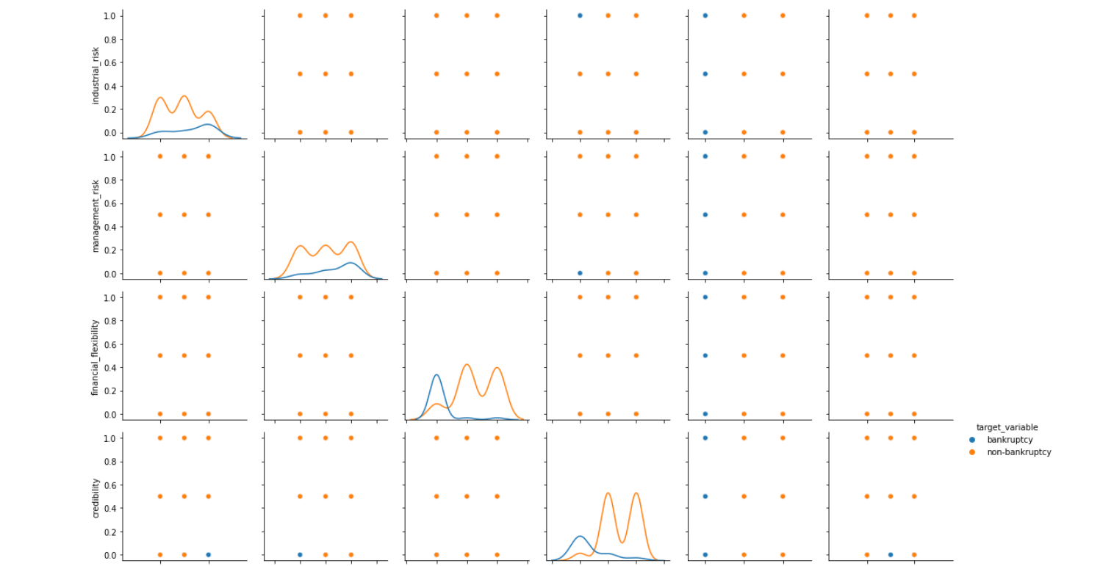
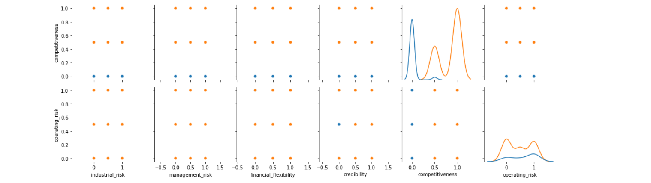
3. If we take a look at the competitiveness, when it is equal to 0 regardless of other features the company going to bankrupt.

Slide 18
02.
II – VISUALIZATIONS & ENCODING VARIABLES
Encode & Visualize the Data for the Insights

Slide 19
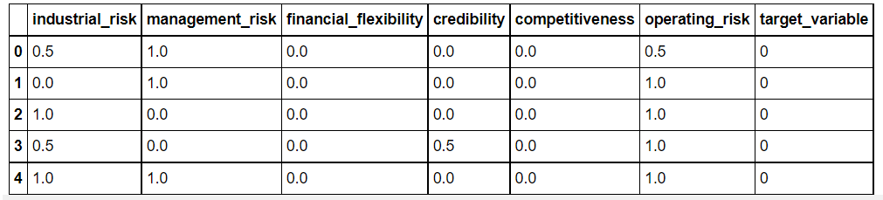
1. Their was one Categorical Variable which is the 'target_variable’ So we converted that into Boolean value 1’s & 0’s using Label Encoder - sklearn.preprocessing Package,Now the entire data is in numericals.

Slide 20
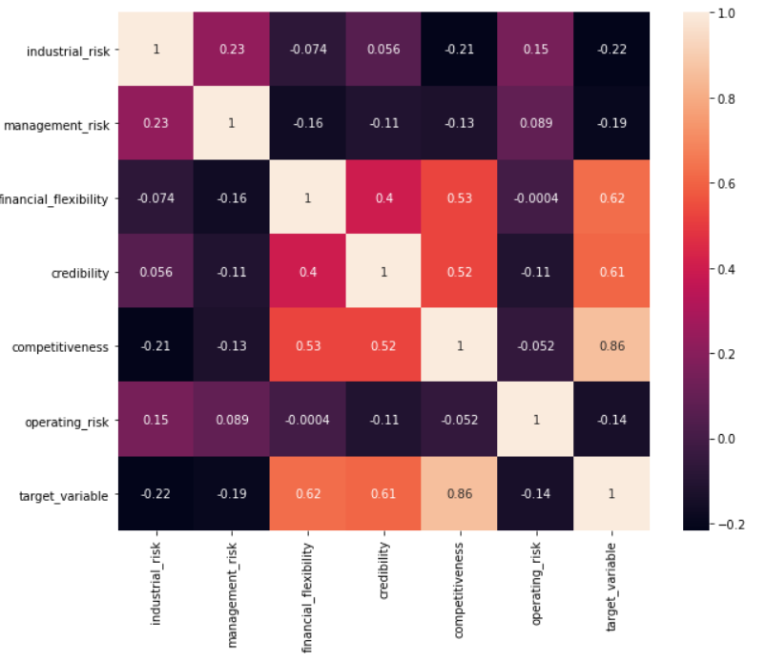
2. Now we used ‘HEATMAP’ to see Correlation within the entire dataset – so we found that :
a. The competitiveness have strong correlation with target variable as observed from scatter plot
b. The credibility, competitiveness and target_variable also have good correlation with each other

Slide 21
03.
MODEL BUILDING & EVALUATION
Building Up The Model & Evaluating It

Slide 22
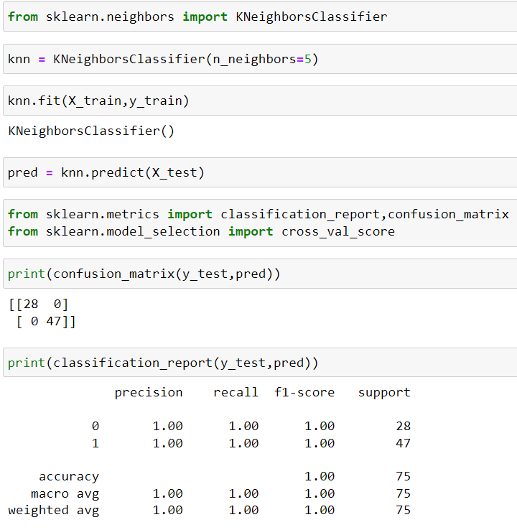
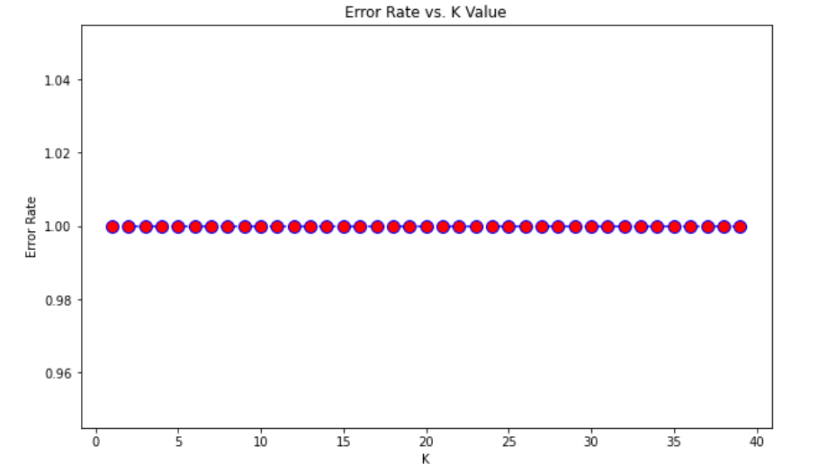
1. K NEAREST NEIGHBORS (KNN)
The abbreviation KNN stands for “K-Nearest Neighbour”. It is a supervised machine learning algorithm.
The algorithm can be used to solve both classification and regression problem statements.
The number of nearest neighbours to a new unknown variable that has to be predicted or classified is denoted by the symbol ‘K’.
It’s aim is to locate all of the closest neighbours around a new unknown data point in order to figure out what class it belongs to. It’s a distance-based approach.
Choosing a K Value

Slide 23
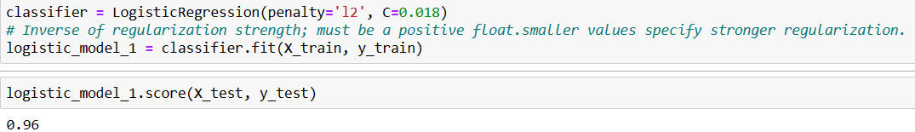
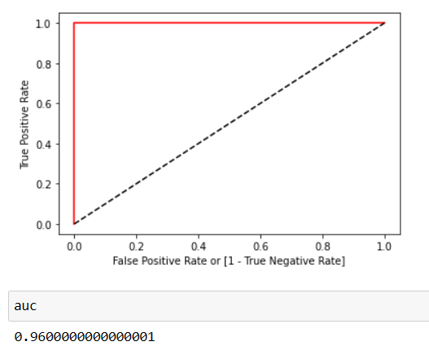
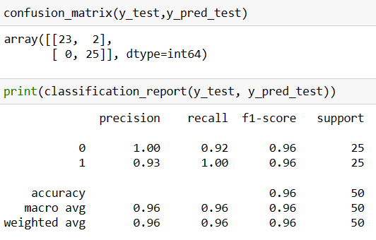
2. Logistic Regression
Logistic regression is a statistical analysis method used to predict a data value based on prior observations of a dataset.
A logistic regression model predicts a dependent data variable by analyzing the relationship between one or more existing independent variables.
The dependent variable in logistic regression is a binary variable with data coded as 1 (yes, True, normal, success, etc.) or 0 (no, False, abnormal, failure, etc.)
A Logistic Regression model is similar to a Linear Regression model, except that the Logistic Regression utilizes a more sophisticated cost function, which is known as the “Sigmoid function” or “logistic function” instead of a linear function
ROC Curve
Model Training
Model Evaluation

Slide 24
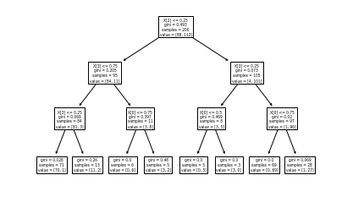
3. DECISION TREE
A decision tree is a decision support tool that uses a tree-like model of decisions and their possible consequences, including chance event outcomes, resource costs, and utility. It is one way to display an algorithm that only contains conditional control statements.
Decision tree methodology is a commonly used data mining method for establishing classification systems based on multiple covariates or for developing prediction algorithms for a target variable. ... When the sample size is large enough, study data can be divided into training and validation datasets.
Entropy can be defined as a measure of the purity of the sub split. Entropy always lies between 0 to 1.
The CART algorithm is a type of classification algorithm that is required to build a decision tree on the basis of Gini's impurity index.
Accuracy :
np.mean(preds==y_test) 0.98
# Checking accuracy of model model_CART.score(x_test, y_test) 0.98

Slide 25
Boosting decision tree models :
We also tried the various boosting models like XGBoost, LightBoost, CatBoost, AdaBoost.
The all models gives 98% accuracy even with the single split. We tried with various changes in the model parameters but still gives 96% or more.

Slide 26
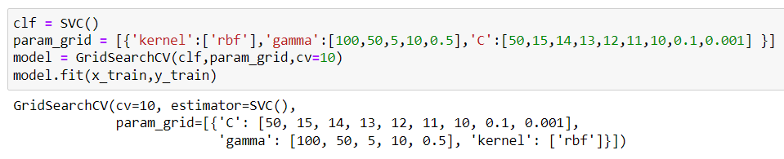
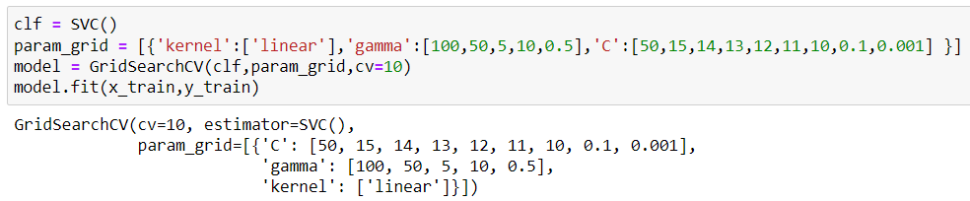
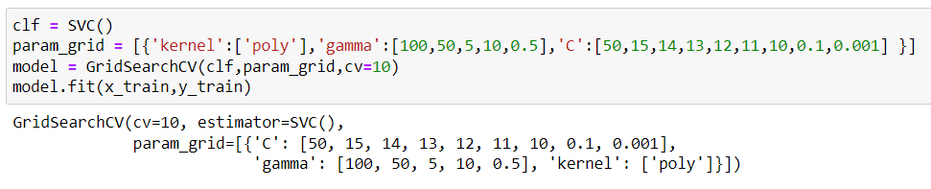
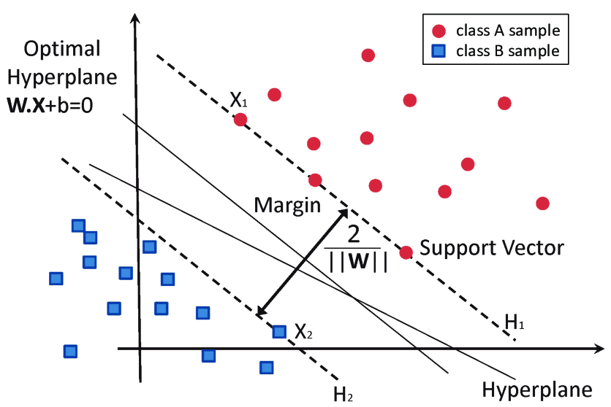
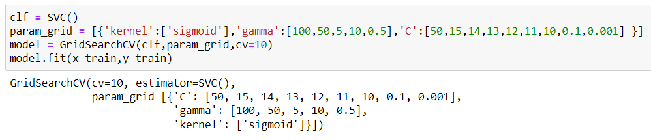
4. SVM
Model name | Parameters | Accuracy
RBF |  | 98%
Linear |  | 98%
Polynomial |  | 98%
Sigmoid |  | 98%
The abbreviation SVM stands for “Support Vector Machine”.It is a supervised machine learning algorithm.
The algorithm can be used to solve both classification and regression problem statements.
It can solve linear and non-linear problems and work well for many practical problems. The idea of SVM is simple: The algorithm creates a line or a hyperplane which separates the data into classes.

Slide 27
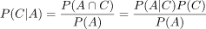
5. NAIVE BAYES
Naive Bayesian classifier inputs discrete variables and outputs a probability score for each candidate class. The predicted class label is the class label with the highest probability score.
It determines the class label probabilities based on the observed attributes. Each feature is assumed to be independent. Class label probability scores are calculated by Bayes’ Law:
3. In practice, we train a model by extracting statistics from the training set. Utilizing a frequency table and a likelihood table for each feature in the calculations facilitates the process.
IMPROVE PERFORMANCE | WON’T IMPROVE
Remove Correlated Features | Hyper-Parameter Tuning
Use Log Probabilities in Calculations | Handling Missing Values
Eliminate the Zero Observations | Training with More Data
Handle Continuous Variables | Dimension Reduction
Handle Text Data | Early Stopping
Re-Train the Model with New Data | Applying Ensemble Methods
Parallelize Calculations

Slide 28
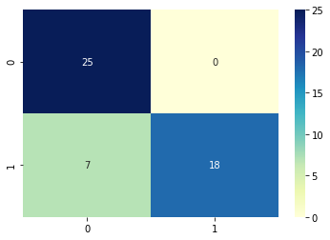
Categorical Naïve Bayes Model
Training Accuracy : 0.91
Classification Report:
Precision Recall F1 – Score Support
1 1.00 0.72 0.84 25
0 0.78 1.00 0.88 25
Accuracy: 0.86 50
Macro avg: 0.89 0.86 0.86 50
Weighted avg: 0.89 0.86 0.86 50
Confusion Matrix

Slide 29
6. NEURAL NETWORK
The given dataset is much smaller so neural network tries to overfit the dataset.
But it is most suitable in case of regularization.
We have trained 4 models with and without regularization.
The selected model consist of Ridge (L2) regularization with value 0.01, dropout of 0.2 and activation function ‘relu’.
The accuracies and respective parameter are given below.
Model name | Parameters | Accuracy
Neural model 1 | 1 hidden layer with 8 nodes, no activation, no regularization, no dropout, 30 epochs | 100%
Neural model 2 | A hidden layer with 6 nodes, ‘relu’ activation, lasso regularization with value 0.01, epochs 20 | 60%
Neural model 3 | A hidden layer with 6 nodes, ‘relu’ activation, Ridge regularization with 0.01, dropout rate 0.1, epochs 60 | 91%
Neural model 4 | A hidden layer with 6 nodes, ‘relu’ activation, Ridge regularization with 0.01, dropout 0.2 and epochs 60 | 95%

Slide 30
* AUTOML
Automated Machine Learning provides methods and processes to make Machine Learning available for non-Machine Learning experts, to improve efficiency of Machine Learning and to accelerate research on Machine Learning.
AutoWEKA is an approach for the simultaneous selection of a machine learning algorithm and its hyperparameters; combined with the WEKA package it automatically yields good models for a wide variety of data sets.
Auto-sklearn is an extension of AutoWEKA using the Python library scikit-learn which is a drop-in replacement for regular scikit-learn classifiers and regressors.
Auto-PyTorch is based on the deep learning framework PyTorch and jointly optimizes hyperparameters and the neural architecture.
AutoKeras An AutoML system based on Keras. It is developed by DATA Lab at Texas A&M University. The goal of AutoKeras is to make machine learning accessible to everyone
Other’s well-known AutoML packages include:
AutoGluon is a multi-layer stacking approach of diverse ML models.
PyCaret is an open source, low-code machine learning library in Python that allows you to go from preparing your data to deploying your model within minutes
H2OAutoML provides automated model selection and ensembling for the H2O machine learning and data analytics platform.
MLBoX is an AutoML library with three components: preprocessing, optimization and prediction.
TPOT is a data-science assistant which optimizes machine learning pipelines using genetic programming.
TransmogrifAI is an AutoML library running on top of Spark.

Slide 31
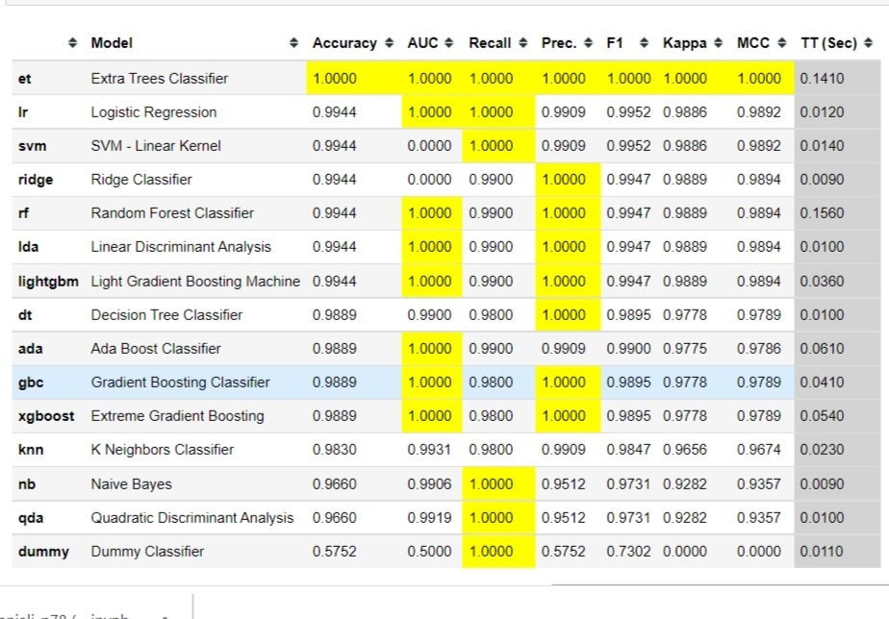
PYCARET COMPARE RESULT

Slide 32
Model Creation & Accuracy
We Created different models & found out this Accuracies for the given models Let’s see each model in detail with their Accuracy :
Model Name | Accuracy
KNN | 100%
Logistic Regression | 96%
Decision Trees (Decision, Random, Adaboost, XGBoost, Lgboost, CatBoost) | 100% , 100%, 98% ,98%, 98%
SVM | 98%
Naïve Bayes | 90%
Neural Network | 95%

Slide 33
CONCLUSION ( from Model Evaluation )
So we performed various MODELS and try to get the best Accuracy after Evaluating all the Models.
Most of the Models results were Overfitted & showing high Accuracy above 98%.
We also performed the AUTOML & compared all the model results.
Finally we found out that NEURAL NETWORK is the good model for this data that provides the accuracy in the range of 60 - 100%.
So we decided to Deploy the Model using ‘ NEURAL NETWORK ‘.

Slide 34
04.
DEPLOYMENT
Deploying The Model

Slide 35
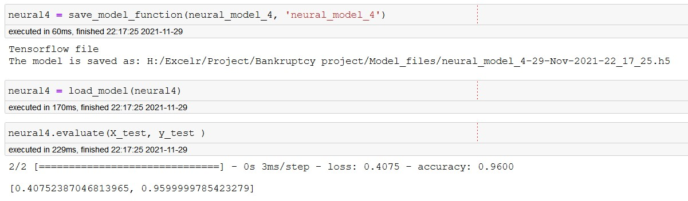
Deployment steps
We have selected the 4th neural network. And converted it to HDF5 file using tensorflow save model method.
For deployment we are using streamlit because of its simplicity, easy to use.

Slide 36
Deployment steps
We have used radio buttons to get inputs for prediction with values 0 as low risk, 0.5 for medium risk and 1 for high risk.
The button is used so that the user can get the output from model.
The information about the features and their details is also added in expanding tab.

Slide 37
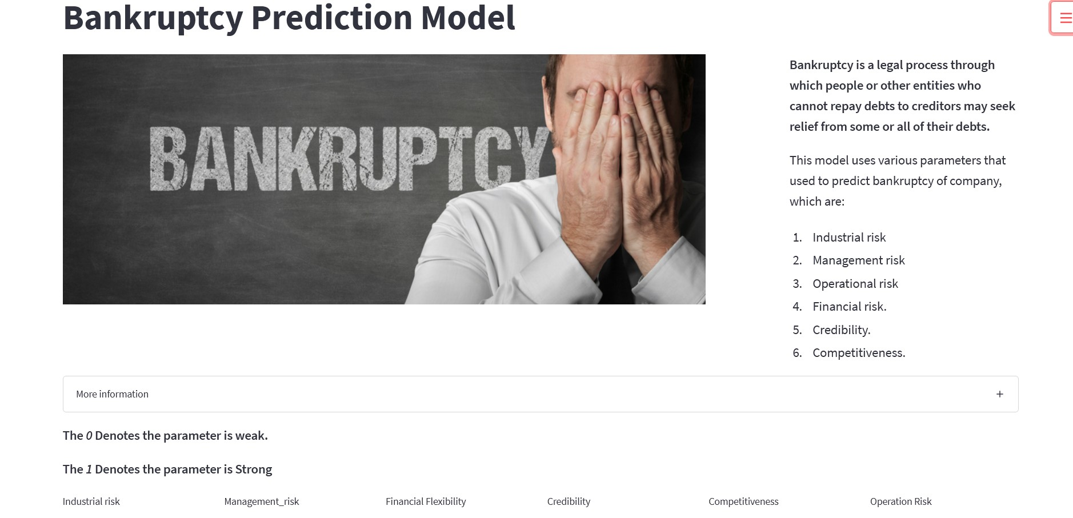
Web app

Slide 38
THANK YOU….!!!

